Slide 1
SPECIATION
E Rayner 2022

Slide 2
Syllabus:
Differing selection pressures between geographically isolated populations may lead to allopatric speciation
Speciation and macro-evolutionary changes result from an accumulation of micro-evolutionary changes over time
Describe the processes that can lead to speciation
Essential
Question:

Slide 3
What you have completed
BIOLOGY WA UNITS 3&4
Chapter 9 Mechanisms of Evolution and Speciation pg. 310 - 316
Questions
Set 9.7 pg. 316

Slide 4
What you need to complete
BIOZONE
232 & 233 – Biological & Phylogenetic Species Concepts
234, 235 – Isolating Mechanisms
236 – Allopatric Speciation
237 – Sympatric Speciation
238 & 239 & 244 – Speciation

Slide 5
The Big Picture - Microevolution
Evolution
1. Mutation
Non-random changes to allele frequency of population
Random changes to allele frequency of population
Variation in Gene Pool
Variation in Populations
2. Natural Selection
Sexual Selection
Artificial Selection (Selective breeding)
3. Genetic Drift
Bottleneck Effect
Founder Effect
Mechanisms of Evolution
Microevolution
4. Gene Flow

Slide 6
The Big Picture micro & Macro evolution
Evolution
1. Mutation
2. Natural Selection
3. Genetic Drift
Mechanisms of Evolution
4. Gene Flow
Microevolution
Long time period (many generations)
Speciation
Macroevolution

Slide 7
Topic Question 1: Define Macroevolution
The evolution of new groups of organisms comprising many related species through multiple speciation events.
Over a long period of evolutionary time. (Many generations)
Above the species level. Trends in whole taxa/lineage
Micro-evolutionary changes accumulate into larger changes.
Changes may become so great that they lead to the production of a new species/speciation.

Slide 8
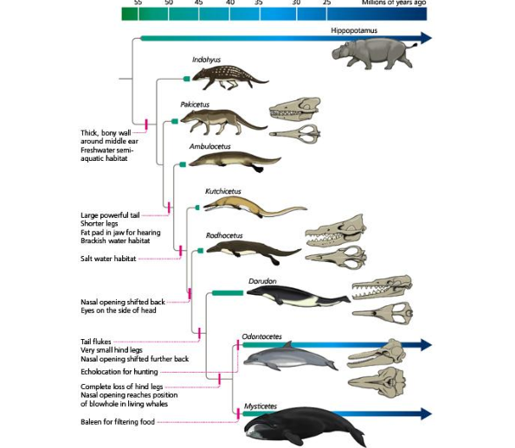

Slide 9
Summary of Speciation
Complete the worksheet as we go thorough the PPT to complete a summary of speciation
You should have read pages 310 – 316 of Biology WA ATAR Units 3 & 4 and completed question set 9.7
Biological species concept
SPECIES
Phylogenetic species concept
SPECIATION
ISOLATION
PRE-REPRODUCTIVE ISOLATION
POST REPRODUCTIVE ISOLATION
TYPES OF SPECIATION

Slide 10
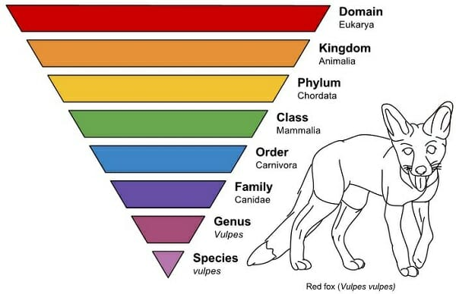
species
What is a species?
Many different concepts used to define a species
Biological species concept: A group of potentially interbreeding natural populations that is capable of producing fertile offspring
Phylogenetic species concept: The smallest group of organisms which is distinguished by a unique set of either genetic or morphological traits (revised morphological species concept). This is how closely related individuals
Notes:
Biological – A genetically isolated group with its own gene pool

Slide 11
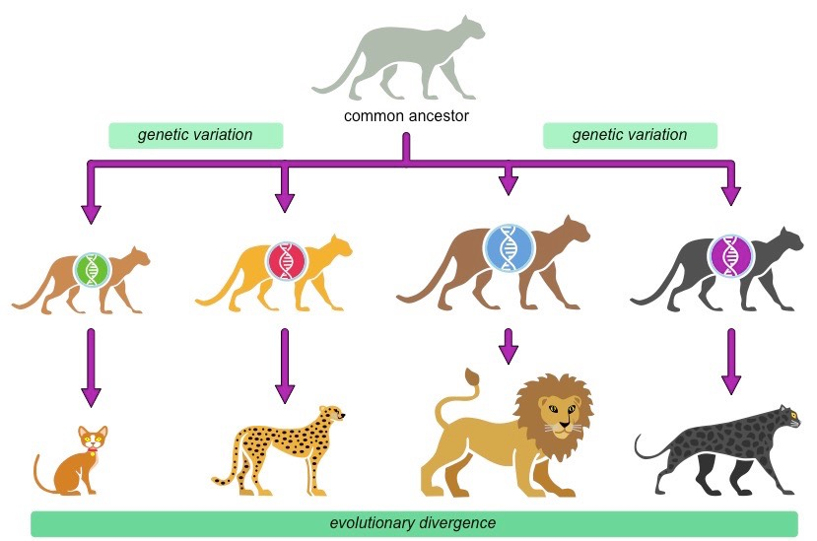
speciation
The evolution of one or more new species from an ancestral species
Notes:
Refers to the process by which new species are formed
Occurs when gene flow has ceased between populations where it previously existed.
Brought about by the development of reproductively isolating mechanisms which maintain the integrity of the new gene pool.

Slide 12
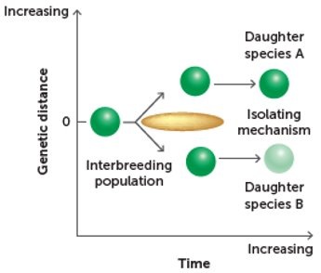
isolation
Mechanisms of Speciation
Speciation occurs when a single population becomes 2 or more separate populations that are unable to interbreed due to changes that produce physical, biological or behavioral barriers
Separation = reproductive isolation
Notes:
Gene pool of the original species divided

Slide 13
Isolating mechanisms
PRE-REPRODUCTIVE ISOLATION
  Temporal (time) breeding different seasons, times of day
  Behavioural mechanisms (different courtship patterns)
  Morphological mechanisms (different shaped reproductive organs)

Slide 14
Isolating mechanisms
POST REPRODUCTIVE ISOLATION
  Gamete mortality (gametes do not survive)
  Zygote mortality (zygote forms but doesn’t survive)
  Hybrid sterility (offspring are formed but are infertile)
Notes:
Continental drift, rising sea levels, climate change – depends of the size a mobility of organisms

Slide 15
Hybrid sterility example question

Slide 17
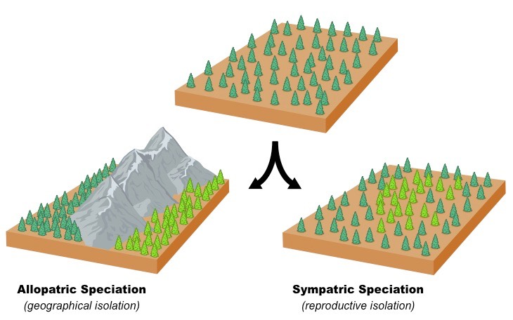
types of speciation

Slide 18
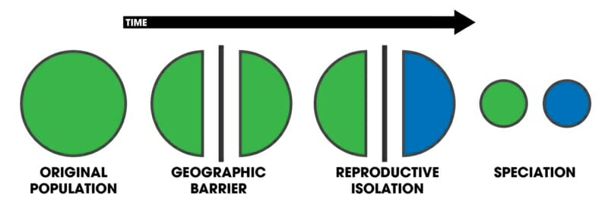
types of speciation
Allopatric
Gene flow is disrupted and a new species may form due to physical separation of populations due to geographical isolation
Water, landforms, mountains, continental drift, rising sea levels, climate change
Notes:
The physical barrier provides an isolating mechanism

Slide 19
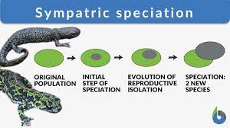
types of speciation
Sympatric
species diverge without any physical separation, formation of new species occurs in the same place
Ecological (habitat) isolation will occur
  Isolating mechanisms include: feeding on different resources, choosing mates based on different characteristics, different habitat preference or different host preference
Instant speciation may occur as a result of polyploidy
  Evolution of wheat

Slide 20
Over to you
Annotate the diagram with the steps of Allopatric Speciation
Make a mind map of speciation
Make flash cards
Practice questions
Watch: https://www.youtube.com/watch?v=udZUaNKXbJA&t=3s

Slide 21
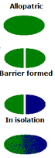
Steps of allopatric speciation
Use the following slides & your own reading to help you annotate the diagram opposite

Slide 22
Allopatric Speciation
Population becomes geographically separated, each being subjected to different natural selection pressures.
Stages
Subpopulations
Isolation by physical barrier
No gene flow
Different selection pressures
Natural selection
Two different species
Genetic drift will occur independently in subpopulations

Slide 23
Allopatric speciation
  1) Moving into new environments.
    Parent population expands its range to occupy new environments due to over population and competition. The population has a common gene pool and gene flow.

Slide 24
Allopatric Speciation
  2) Geographical Isolation
    Gradual formation of physical barriers may isolate parts of the population so that gene flow between groups stops.
    Causes of geographical isolation include.
          Continental drift
          Changes in sea levels
          Climate change
          Rivers
          Canyons
          Mountain ranges

Slide 25
Allopatric Speciation
  3) Natural Selection
    The isolated populations maybe subjected to quite different selection pressures or/and mutations.
    These selection pressures will favour those individuals with phenotypes that suit each environment.
    Allele frequencies in the gene pools of the populations will change as those individuals with favourable phenotypes mate and pass on their genes to the next generation.
    Populations can change in phenotype and become sub species of the parent population.

Slide 26
Allopatric Speciation
  4) Reproductive Isolation
    To become a separate species the populations need to become reproductively isolated from other populations.
    So even if the geographically barriers are removed and the populations can mix, they have changed in phenotype and behaviour that mating is prevented.
    Definition of a species:
    A group of actually or potentially interbreeding natural population that is reproductively isolated from other such groups.

Slide 27
Reproductive Isolating Mechanisms
Prevent successful breeding between different species – barriers to gene flow.
Most species have more than one isolating mechanism operating.
Geographical barriers are not a reproductive isolating mechanism.

Slide 28
Reproductive Isolating Mechanisms
Pre-zygotic (pre-fertilisation)
  Temporal Isolation – species may have different activity patterns – they may be nocturnal or diurnal, or breed at different seasons.
  Behavioural Isolation – species may have specific calls, rituals, postures etc. which enable them to recognise potential mates.
  Structural Isolation – mating species must have compatible copulatory apparatus, appearance and chemical make up (odour, chemical attractants)
  Gamete Isolation – sperm and egg fail to unite.

Slide 29
Reproductive Isolating Mechanisms
Post-zygotic (post fertilisation)
  Hybrid sterility – the hybrid of two species may be viable but sterile – unable to breed e.g. mule/hinny, tigon/liger, zebronkey
  Hybrid Inviability – fertilised egg may fail to develop properly.
  Hybrid Breakdown – the first generation may be fertile but subsequent generations are infertile or non-viable.
  (Biozone Act 234, 235)

Slide 30
2014 exam question

Slide 31
2017 Exam Answer

Slide 32
2020 Exam Answer

Slide 33
2014 exam answer

